Slide 1
Middle Neck Road and East Shore Road Corridor Study, Zoning Amendments and Draft Generic Environmental Impact Statement
Public presentation
Village of Great Neck, NY
February 5, 2019

Slide 2
Agenda
Middle Neck Road and East Shore Road Corridor Study
Proposed Changes to Village Zoning Code
Summary of DGEIS Topics

Slide 3
Three steps:
Corridor Study: Existing conditions and recommendations with valuable input from the Community Advisory Committee
Regulatory: Changes to Village Zoning Code to achieve the Corridor Study’s recommendations
Environmental: Draft Generic Environmental Impact Statement required under the New York State Environmental Quality Review Act to identify and mitigate potential environmental impacts of the proposed zoning changes

Slide 4
Middle Neck Road and East Shore Road Corridor Study

Slide 6
Overview
MNR and ESR are the principal business corridors in the Village
MNR has not achieved the potential envisioned (limited new residential construction and commercial vacancies)
ESR lacks connection to Manhasset Bay and has unrealized potential to support additional residences and businesses

Slide 7
Goals of the MNR and ESR Corridor Study
Identify potential zoning amendments that encourage the revitalization and capital investment in the physical, social and financial well-being along MNR and ESR:
Diversified housing options
Reduced commercial vacancies
Increased tax base
Improved property values
Enhanced streetscape and access to public spaces
Traffic calming and pedestrian safety

Slide 8
Properties of Interest
Potentially suitable for revitalization
Proximity to commercial district
Proximity to waterfront
Proximity to open space
Size of lot and location
Recently redeveloped or publicly known proposals
Form the basis of the Maximum Potential Build-Out Scenario

Slide 11
Vision for the MNR and ESR Corridors
Re-establish both corridors as key destinations for local residents and visitors
Provide a variety of housing options to appeal to empty nesters and new families
Offer a high quality-of-life and critical mass of diverse public and private amenities
Allow uses that serve as catalysts for increased and sustainable development now, and for future generations

Slide 12
Proposed Zoning Amendments

Slide 13
Key Recommendations from the Corridor Study
Amend the incentive zoning to encourage:
Assisted living
Affordable workforce housing
Ground floor commercial uses
Public improvements (streetscape, pedestrian, traffic calming, shuttle service)

Slide 16
Proposed Zoning Changes
Middle Neck Road Multifamily Incentive Overlay District (MNR-MIO) -> “Corridor Incentive Overlay District” (CIO)
Amend the Zoning Map
Mandatory public notice and hearing for all applications under the incentive zoning procedure

Slide 17
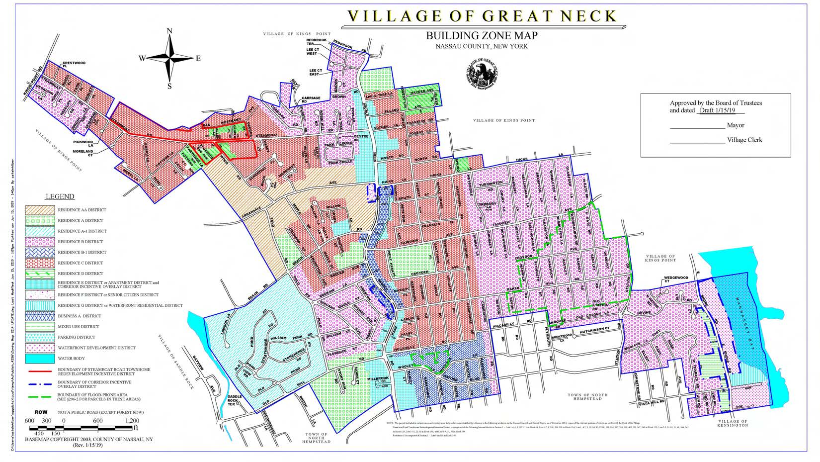

Slide 18
Proposed Zoning Changes (cont’d)
Assisted Living now a permitted use in the CIO District
Ground floor commercial, affordable workforce housing and assisted living identified as presumptive community benefits/amenities in the CIO District subject to approval by the Board of Trustees
Affordable Workforce Housing defined per Long Island Workforce Housing Act:
Affordable to households at or below 130% of the median income for the Nassau-Suffolk area
10 percent affordable units
Grants Board of Trustees discretion to characterize other public amenities as community benefits under the incentive zoning procedure

Slide 19
Proposed Zoning Changes (cont’d)
Limits the height of incentivized structures to 5 stories (52 feet)
30-foot base height followed by a 5-foot minimum first setback above then 3-foot minimum setbacks above
Allows case-by-case relaxation of parking requirements as an incentive on MNR
Parking relaxations as an incentive on ESR only when a substantial hardship and minimal adverse impact on parking capacity is shown

Slide 20
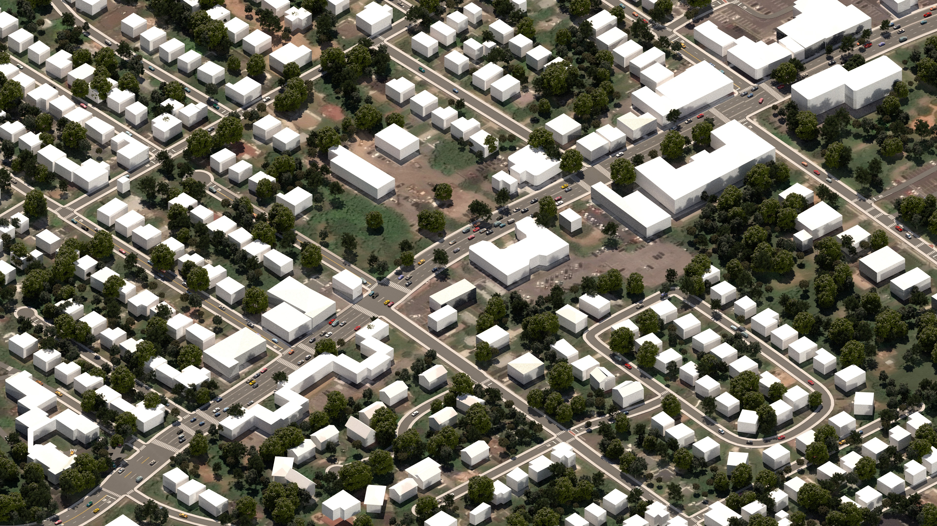
Hicks Lane
Middle Neck Road
Arrandale Avenue
Gutheil Lane
Middle Neck Road
Steamboat Road
Existing Conditions-Middle Neck Road
Village of Great Neck, New York

Slide 21
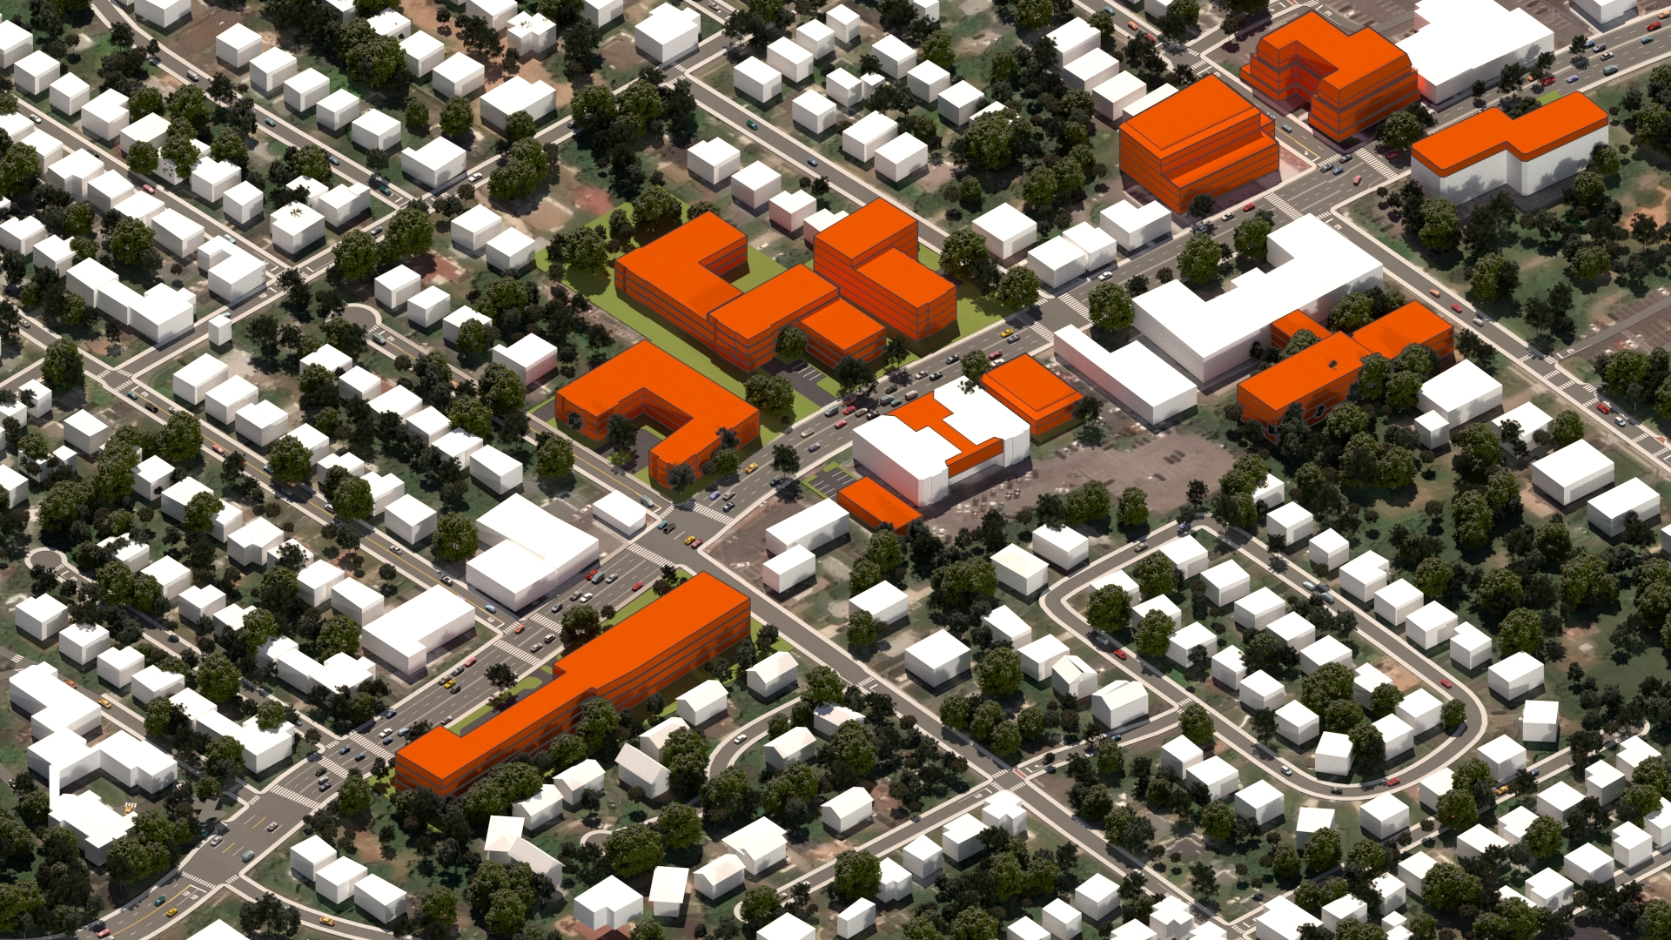
Hicks Lane
Middle Neck Road
Arrandale Avenue
Gutheil Lane
Middle Neck Road
Steamboat Road
Theoretical Development under Proposed Zoning-Middle Neck Road
Village of Great Neck, New York

Slide 22
Draft Generic Environmental Impact Statement

Slide 23
Environmental Topics Reviewed in Accordance with the New York State Environmental Quality Review Act (SEQRA)
Soils and Topography
Water Resources
Ecology
Land Use and Zoning
Traffic and Parking
Air Quality
Noise
Socioeconomics
Community Facilities and Services
Aesthetics
Cultural Resources
Cumulative

Slide 24
Conditions and Criteria Under Which Future Actions will be Undertaken or Approved including Requirements for Subsequent SEQRA Compliance
The proposed action does not entail specific development, but instead may facilitate or encourage development.
In order for the decision-making process to appropriately account for uncertainties related to the potential impacts of future actions, the SEQRA regulations, set forth provisions for the establishment of conditions and criteria governing such future actions.
In the event that any of the conditions proposed are to be exceeded by future development, additional SEQRA compliance would be necessary.

Slide 25
Build-Out Comparison (Middle Neck Road)
Parameter | Existing Conditions | Maximum Build-Out (Existing Zoning) | Maximum Build-Out (Proposed Zoning)
Residential Units | 296± units | 546± units | 552± units and 100 assisted living units
Commercial Area | 40,670± SF | 11,196± SF | 29,196± SF
Population | 638± residents | 1,236± residents | 1,399± residents
Public School-Aged Children | 36± students | 86± students | 82± students
Direct Employment | 123± jobs | 64± jobs | 138± jobs
Trip Generation (AM Peak Hour) | 227± trips | 236± trips | 329± trips
Trip Generation (PM Peak Hour | 378± trips | 313± trips | 461± trips

Slide 26
Build-Out Comparison (East Shore Road)
Parameter | Existing Conditions | Maximum Build-Out (Existing Zoning) | Maximum Build-Out (Proposed Zoning)
Residential Units | 191± units | 215± units | 417± units
Commercial Area | 104,696± SF | 71,000± SF | 29,500± SF
Population | 442± residents | 497± residents | 964± residents
Public School-Aged Children | 31± students | 35± students | 67± students
Direct Employment | 264± jobs | 183± jobs | 89± jobs
Trip Generation (AM Peak Hour) | 139± trips | 69± trips | 127± trips
Trip Generation (PM Peak Hour | 179± trips | 201± trips | 214± trips

Slide 27
Next Steps:
Public comment period will extend through February 19, 2019
Public hearing on draft zoning changes will occur on February 19, 2019
Final Generic Environmental Impact Statement (FGEIS), responding to public comments, will be prepared and submitted to Lead Agency
Once the FGEIS is filed, a minimum 10-day consideration period will commence
SEQRA Findings Statement will be adopted after conclusion of FGEIS consideration period, within 30 days of the FGEIS filing date
After Findings Statement is adopted, Board of Trustees can hold a vote on the proposed zoning amendments

